Slide 1

Books Shop listing app
Abhinav T.
Divya Prakash
Samreen Liyakhat
Samuel Tigga
Neha Sapalya
Neha Mittal

Slide 2





INTRODUCTION
We have developed a book app website with name Book Store
This website consists of two modules
User
Admin
User: It has the access to books in our database, and can buy them
Admin: It has the access to modify, delete and add books

Slide 3
TECHNOLOGIES
Git
Spring Boot
Docker
MySQL
Thymeleaf

Slide 4
Login
User page
Admin page

Slide 5

User Operation
Landing page
Login
Registration
Home
Books

Slide 6
Available books
Buy now
Add to cart
Payment
Receipt
Confirmation
Home

Slide 7
Admin Operation
Landing page
Login Page
Admin Table
(CRUD)

Slide 8

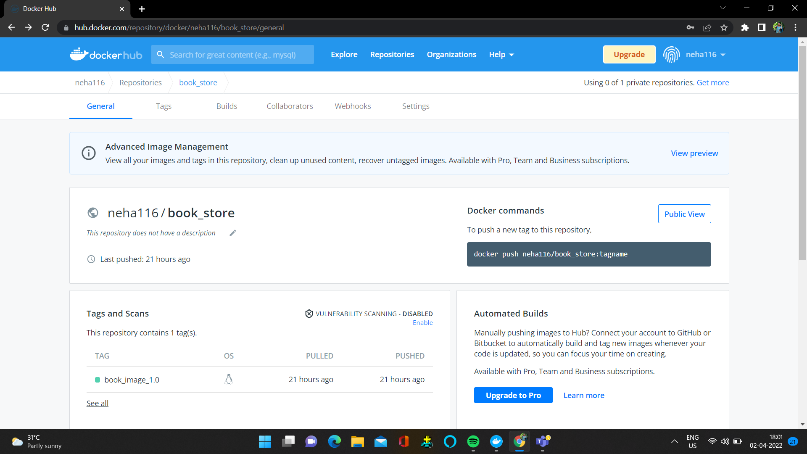

Docker
1 version of our project has been dockerized.
Latest version 2.5, our final version.

Slide 9
Agile Process

Slide 10
Product Backlog
Login and Registration page.
Home Page.
Books Table.
Cart Page.
Cart Page calculation.
Payment.
Confirmation Page.
Receipt Page.
Admin Page.
Admin Operations.

Slide 11

Thank you

